Slide 1
Hardness Testing
Hardness – Hardness is closely related to strength. It is the ability of a material to resist scratching, abrasion, indentation, or penetration.
Purpose of hardness testing
The principal purpose of hardness test is to determine the suitability of a material for a given application.
It gives indirect measure of strength of material. Materials with higher hardness have higher tensile strength and brittleness. Softer material more ductile.
It gives indication about the resistance of materials to the plastic deformation and wear. Where Large hardness means high resistance of material
Static indentation test
A ball, cone, or pyramid is forced into the surface of the metal being tested.
The relationship of load to area or depth of indentation is the measure of hardness.
The hardness can be done by the following methods:
Brinell Hardness Test
Vickers Hardness Test
Rockwell Hardness Test
Knoop Hardness Test
1

Slide 2
Figure 1
Tensile strength (Mpa)
Tensile strength (Mpa)
Brinell hardness

Slide 3
General types of Current hardness testing…..
Current practice divides hardness testing into three categories:
Macrohardness:
Refers to testing with applied loads on the indenter of more than 1 kgf and material being tested are tools, dies and sheet material in the heavier gages (in large scale)
Microhardness:
Refers to testing with applied loads are 1 kgf or below, and material being tested is very thin (down to 0.0125 mm).
Nanohardness:
Tests measure hardness by using indenter, on the order of nano scale.
These tests are based one new technology that allows precise measurement and control of the indenting forces and precise measurement of the indentation depth.

Slide 4
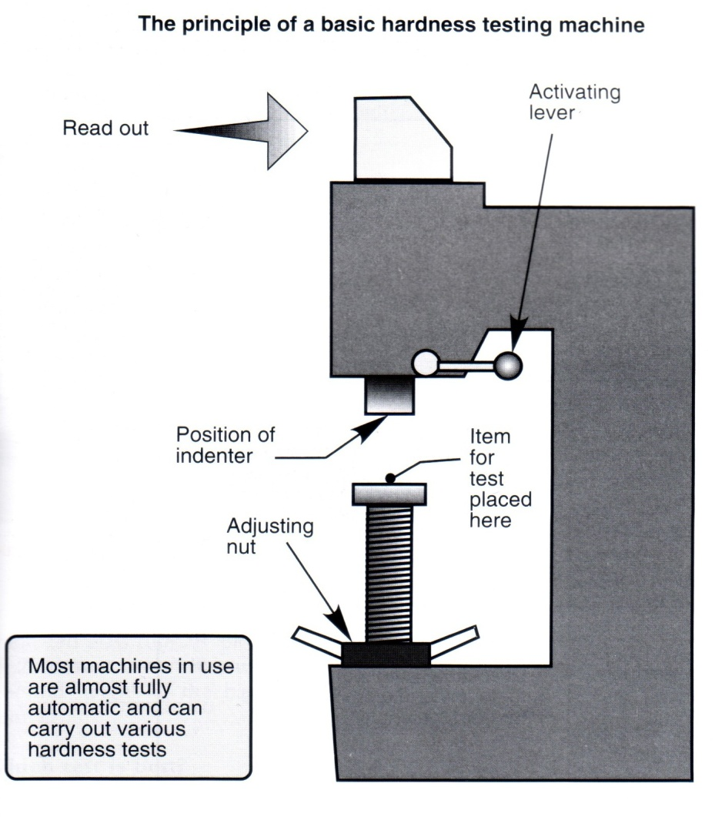
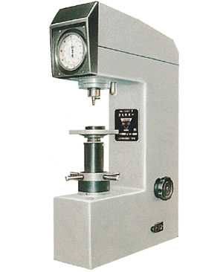
Hardness test procedure
The indenter is pressed into the metal
Softer materials leave a deeper indentation

Slide 5
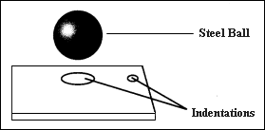
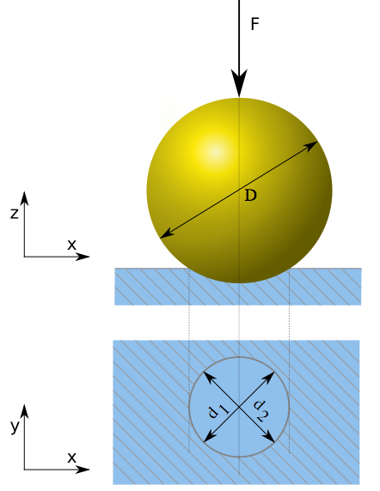
Brinell Hardness Test (HB)
Introduction:
A Swedish, J.A.Brinell, announced Brinell hardness test. He pressed an indenter with a hard ball to the surface of a metal. During testing period, the weights were maintained constant in indicated time. A low-order microscope measured the diameters of indentations. The values of diameters will be transferred respectively into the value of Brinell hardness, HB value.
Brinell hardness impression

Slide 6
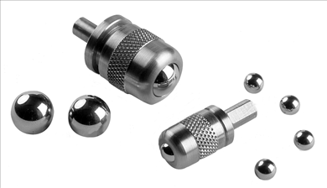
The test be made with a ball of 10 mm diameter under a load of 3,000 kgf for ferrous metals the loaded ball is pressed into the specimen for at least 10s.
But for non-ferrous these parameter are different in which load of 500 kgf is applied for 30s.
The diameter of the impression produced is measured by means of a microscope containing an ocular scale, usually graduated in tenths of a millimeter, permitting estimate to the nearest 0.05 mm.
P= Load placed on ball, usually 3000 kg , but 1500 kgf, and 500 kgf can also be used.
D = Diameter of steel ball ( = 10 mm)
d = diameter of dent, measured by looking through a Brinell microscope.
What the meaning 250HB10/3000 ?
HB Brinell hardness, 250 the value of hardness , 10 is the ball diameter, 3000 is the force to apply (in kgf)

Slide 7
3.) Advantages of the Brinell Test
Widely used and well accepted
Large ball gives good average reading with a single test.
Accurate
Easy to learn and use
4.) Disadvantages of the Brinell Test
Destructive and Ball may deform on very hard materials (Test is no good if HB > 650)
Non-portable
High initial cost ($5,000)
Error due to operator reading Brinell Microscope (10%max)
Cannot be used for thin materials. Sample must be eight or ten times thicker than the indentation depth (h) .

Slide 8
Applications:-
Because of the wide test force range the Brinell test can be used on almost any metallic material. The part size is only limited by the testing instrument's capacity.
Example: The Brinell hardness of an alloy steel is 355. Compute the diameter of the indentation if a load of 2000 kgf was used and estimate the corresponding tensile strength of the material.
Solution
HB

Slide 9
Rockwell Hardness
Introduction:
S.P. Rockwell announced hardness test in 1919. In the United States; however, it was used to practical by C.H. Wilson.
Different weights composed of different material indenters will inspire various usages. There are two kinds of indenters, one is with a steel head and the other is with a diamond head. Rockwell hardness test is the most popular hardness test nowadays.
Types of Rockwell testing
Rockwell regular testing:
In Rockwell regular testing the minor load is 10 kgf and major load (60, 100, or 150 kgf) is used regardless of the type of indenter.
Rockwell superficial testing:
In Rockwell superficial testing minor load is 3 kgf and major loads (15, 30 or 45 kgf) are used.
Test Procedure
Apply a minor load of 10 kgf.
Then the dial is set to zero .
Then apply major load 60 to 150 kgf according to the scale used for 4 to 5 seconds.
Release the major load only.
Machine will show the Rockwell Hardness Number HR on the machine.
All these operation will be done by machine automatically.
9

Slide 10
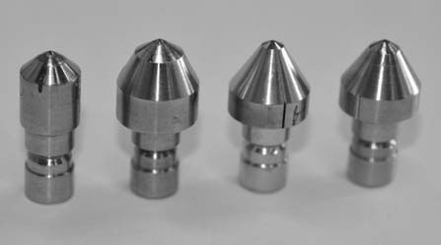
Figure: Tip Panetration
F0 = preliminary minor load in kgf
F1 = additional major load in kgf
F = total load in kgf
Types of indenters used are :
Steel ball used for soft materials.
Cone diamond used for hard materials.
The Rockwell hardness number is given by:
Rockwell hardness = E – h
E is a constant determined by the form of the indentor; for diamond cone indenter E is 100, for a steel ball 130
h is the penetration depth

Slide 11
Advantages of Rockwell hardness test:
Highly skilled operators are not required.
Different types of loads and indenters can be used.
Rapid testing time. The entire operation completes within 10 sec.
Flexible, quick and easy to use.
Disadvantages Rockwell hardness test :
Possible errors due to shifting of the sample under test load during test cycle. During manual operation, the work piece should be raised very slowly with the screw as it approaches the indenter.
Quality of the indenter has a strong influence on the test result. The surface being tested must be perpendicular to the direction of the force on the indenter within 2-5 degree. Careless operation in applying load, not only result in accurate reading but can damage the indenter.

Slide 12
Rockwell Scales
The Rockwell scale is a hardness scale based on indentation hardness of a material. Rockwell hardness values are expressed as a combination of a hardness number and a scale symbol representing the indenter and the minor and major loads. The hardness number is expressed by the symbol HR and the scale designation. There are different scales. The majority of applications are covered by the Rockwell C and B scales for testing steel, brass, and other metals.
scale being determined by indenter and full load use .
Scale A : which is use in conjunction with diamond cone and 60kgf load .it is use for very hard material such as tool steel.
Scale B : which is use in conjunction with 1/16 inch diameter steel ball and 100kgf load. it is use for soft material such as copper alloy ,mild steel etc.
Scale C: which is use in conjunction with diamond cone 120 degree angle and 150kgf load .it is use for hardened steel , hard cast iron.

Slide 13
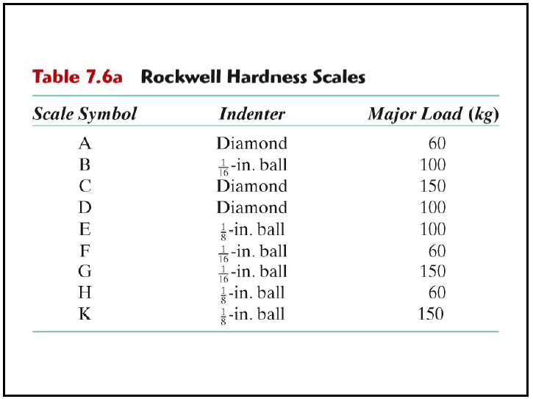
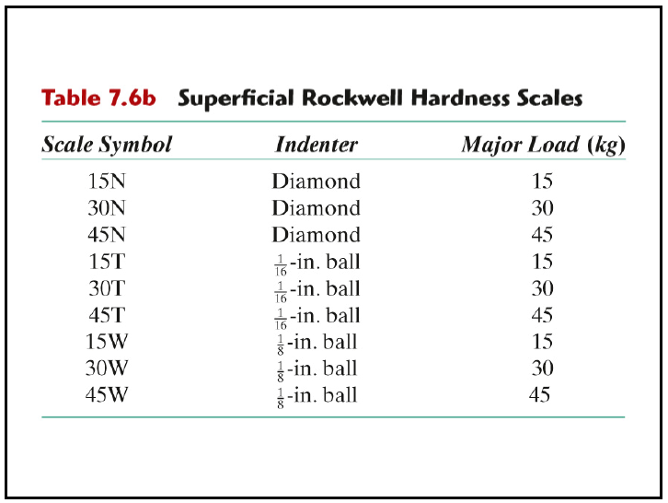
Table1 : Regular Rockwell Hardness Scales
Table 2: Superficial Rockwell Hardness Scales
Example: 80 HR30N means that Rockwell 30N scale using diamond indenter with 30 kgf load produced a Rockwell hardness of 80 kgf / mm²
Example: 80HRC means that Rockwell C scale using diamond indenter with 150kgf load produced a Rockwell hardness of 80 kgf / mm²

Slide 14
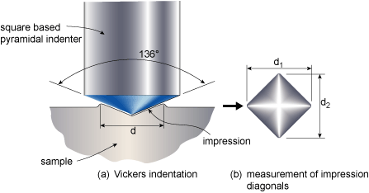
Vickers hardness test
Introduction:
The Vickers (HV) test was developed in England is 1925 and was formally known as the Diamond Pyramid Hardness (DPH) test.
Uses square shaped pyramid indenter.
The Vickers test has two distinct force ranges, micro (10g to 1000g) and macro (1kgf to 100kgf), to cover all testing requirements.
Measures length of diagonal on indentation.
Vickers Hardness = P/A
HV = 2P sin (θ/2)/d² =1.8544P/d²
P = load, kgf
d = mean diagonal of impression, mm
θ = face angle of diamond = 136°
HV =1.8544P/d²
Applications
Because of the wide test force range, the Vickers test can be used on almost any metallic material. The part size is only limited by the testing instrument's capacity.
Figure :The Vickers pyramid hardness test,

Slide 15
Vickers Hardness Test Procedure
The indenter is pressed into the sample by an accurately controlled test force.
The force is maintained for a specific dwell time, normally 10 – 15 seconds.
After the dwell time is complete, the indenter is removed leaving an indent in the sample that appears square shaped on the surface.
The size of the indent is determined optically by measuring the two diagonals of the square indent.
The Vickers hardness number is a function of the test force divided by the surface area of the indent.
Example: 375 HV₃₀₀ means that a 300 kgf loads produced a Vickers hardness of 375 kgf / mm².

Slide 16
Advantages
1. One scale covers the entire hardness range. Continuous hardness from soft (5 HV) to hard materials (1500 HV)
2. A wide range of test forces to suit every application. Vickers values are generally considered test force independent. In other words, if the material tested is uniform, the Vickers values will be the same if tested using a 500gf force or a 50kgf force.
3. Small indentation compared to HB, sample can normally be used.
Disadvantages
1. The main drawback of the Vickers test is the need to optically measure the indent size. This requires that the test point be highly finished to be able to see the indent well enough to make an accurate measurement.
2. Slow. Testing can take 30 seconds not counting the sample preparation time.

Slide 17
Knoop Hardness Test
Knoop (HK) hardness was developed by at the National Bureau of
Standards (now NIST) in 1939.
The indenter used is a rhombic based
pyramidal diamond that produces an elongated diamond shaped indent. Knoop tests are mainly done at test forces from 10g to 1000g, so a high powered microscope is necessary to measure the indent size. Because of this, Knoop tests have mainly been known as microhardness tests. The newer standards more accurately use the term micro indentation tests. The magnifications required to measure Knoop indents dictate a highly polished test surface. To achieve this surface, the samples are normally mounted and metallurgically polished, therefore Knoop is almost always a destructive test.

Slide 18
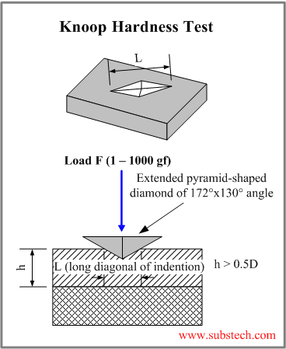
Applications:-
Because of the wide test force range, the Knoop test can be used on almost any metallic material. The part size is only limited by the testing instrument's capacity.

Slide 19
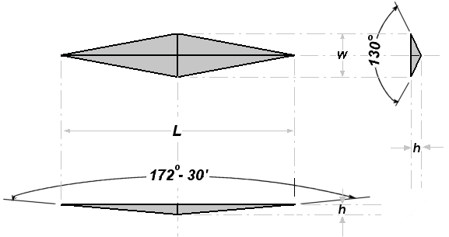
The Knoop hardness number HKN is the ratio of the load applied to the indenter, F (kgf) to the unrecovered projected area A (mm²)
L
HK = P/A
HK = 14.229(P/L²)
Where: P= applied load in kgf
A = the unrecovered projected area of the indentation in mm²
L = measured length of long diagonal of indentation in mm
Example: 375 HK₃₀₀ means that a 300 gf load produced a Knoop hardness of 375 kgf / mm².

